Slide 1
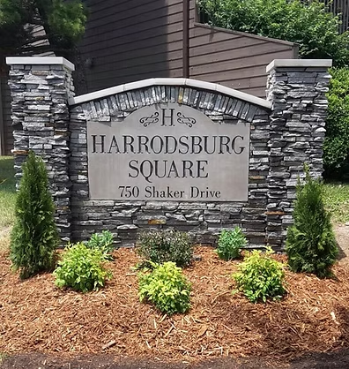
HARRODSBURG SQUARE
OCTOBER 13TH, 2026
6:30 PM

Slide 2
AGENDA
SIGN IN, RECEIVE BALLOT
YEAR TO DATE REPORTS AND UPDATES
OLD BUSINESS - Need Quorum to pass
NEW BUSINESS - 2027 BUDGET, STRATEGIC PLAN, ELECTION RESULTS
NEXT MEETING – JANUARY 11TH, 2027

Slide 3
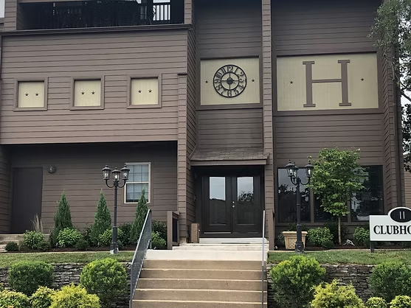
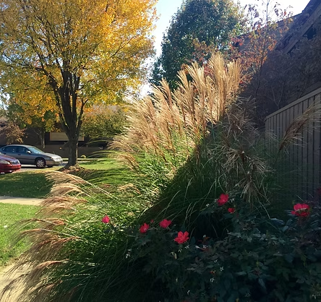
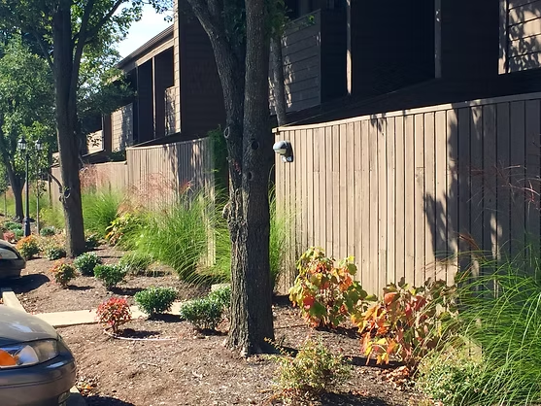
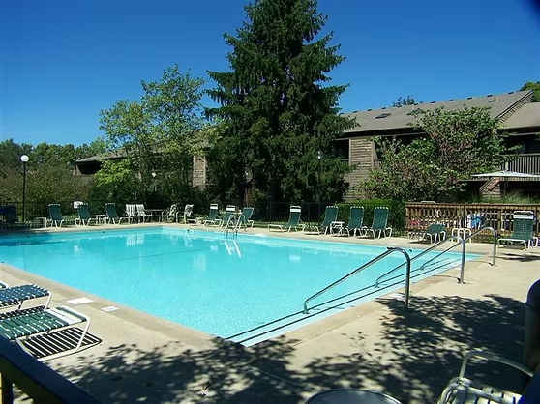
BOARD
REPORT
CONTRACTS
FIRE SUPPRESSION
HMC AND WATER LEAK
SECURITY, CAMERAS, AND DUMPSTERS
MAINTENANCE STUDY

Slide 4

TREAURER’S REPORT
QUARTERLY REPORTS
NEW MANAGEMENT COMPANY
CD’s AND MONEY MARKET

Slide 5


Condo sales
(nOV 2025 – sep 2026)
Date Sold | Beds/Baths | Sale Price | Sq Ft
11/14/2025 | 2/2 | $196,000 | 1028
2/20/2026 | 2/2 | $195,000 | 1028
3/16/2026 | 1/1 | $107,000 | 795
5/19/2026 | 3/2 | $209,000 | 1494
7/16/2026 | 2/2 | $145,000 | 1028
7/20/2026 | 2/2 | $187,000 | 1028
7/27/2026 | 2/2 | $182,500 | 1028
8/5/2026 | 3/2 | $218,000 | 1494
8/24/2026 | 3/2 | $220,000 | 1494
9/22/2026 | 1/1 | $145,000 | 795
Average per square foot is $163
up $9.00 since last year

Slide 6



Utility and insurance PERCENTAGES OF DUES
UTILITY PORTION OF HOA MONTHLY DUES
2022 – 54%
2023 – 52%
2024 – 52%
2025 – 54%
2026 – 54%(projected)
2027 – 53%(projected)
INSURANCE PORTION OF HOA MONTHLY DUES
2023 – 6%
2024 – 8%
2025 – 10%
2026 – 13%(projected)
2027 – 11%(projected)
FUNDING RESERVE
2025 – 0%
2026 – 0%
2027 – 10%

Slide 7


ELECTION OF
BOARD MEMBERS
BECKY WILLIAMS
KREIG CREMEANS
JUDITH PERKINS
DERRICK SMITH

Slide 8
OLD BUSINESS/NEW BUSINESS
EMERGENCY PLAN
CORRECT SQ. FOOTAGE IN BY-LAWS
ELECTION
BUDGET
STRATEGIC PLAN

Slide 9


ELECTION RESULTS

Slide 10
THANK YOU
NEXT QUARTERLY MEETING
JANUARY 11TH, 2027, 6:30pm
In the Clubhouse

